Slide 1
Planning Phase
Analysis Stage

Slide 2
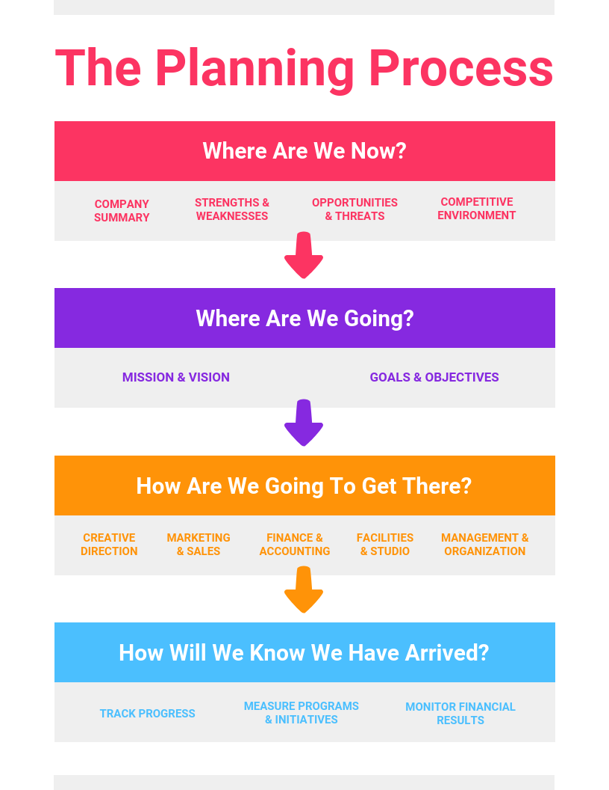

Slide 3
Analysis Stage
> Situation and problem analysis – This involves identifying the main strengths, interests, needs, constraints and opportunities of the implementing team and of key stakeholders and identifying the problems that need to be solved and their causes and consequences.
> Development of objectives – This involves developing objectives based on the identified problems and verifying the cause-effect relationships.
> Selection of objectives – This involves identifying the different options available to achieve the main objective and determining which one the implementing team or agency is best suited to tackle.

Slide 4
1 Situation and problem analysis
Aim: to understand in more detail the information gathered during the assessment phase.
It is often a transitional step between initial assessment and design, but exactly what steps are necessary will depend on how the initial assessment was carried out.

Slide 5
It is therefore useful for the people who carried out the initial assessment to participate in this stage of the planning phase.
As a general rule, if the assessment team has already completed some of the steps outlined here (e.g. stakeholder analysis or problem analysis) and there is a consensus on the conclusions and recommendations between all those involved in the assessment and the planning of the intervention, these steps do not need to be repeated or supplemented.

Slide 6
Tools for Analysis
A tool is only useful if used at the right time and in the right way. The same tool can also be used at different times.
1. Stakeholder analysis – to assess the problems, interests and potential of different groups in relation to the conclusions of the assessment
2. SWoT analysis – a tool with a wide range of uses, including, as suggested here, to assess the capacity of the implementing agency or team
3. Problem tree analysis – to get an idea of the main problems and their causes, focusing on cause-effect relationships

Slide 7
1. Stakeholder analysis
“Stakeholder” is a person or group of people who have an interest in the intervention that is being planned.
“Stakeholder analysis” is a technique used to identify and assess the interests of the people, groups or institutions that the intervention seeks to help and of others who may significantly influence the intervention’s success.
Overall Aim of stakeholder analysis = to ensure that the intervention takes place in the best possible conditions, by aligning it realistically with the needs and capacities of the stakeholders.

Slide 8
2. Stakeholders Analysis
Drawing up comparative table to identify the stakeholders
Stakeholders are categorized as follows:
a) Institutions that will potentially be involved in the intervention:
b) Target groups, for example vulnerable groups or potential beneficiaries, such as “mothers with young children”, “youth population under 30 years old” or, for a capacity-building project, “the National Society’s youth members”, etc.
c) others, for example various associations, local groups, schools, local NGOs, community leaders, the media, etc.

Slide 9
1. Stakeholders Analysis
Second, the problems, interests, needs, potential, interaction and other relevant factors are identified and analyzed for each stakeholder.
The factors to be considered for each stakeholder may vary from context to context, but some key factors would normally include:

Slide 10
1. Stakeholders Analysis (Red Cross)
The factors to be considered for each stakeholder may vary from context to context, but some key factors would normally include:
a) Problems: What are the key problems identified in the assessment and affecting the stakeholder in question? (e.g. poor health care/education, poor crop yield, high unemployment, etc.)
b) Interests: What motivates the stakeholder group? (e.g. music and dance, sport, technology, recognition, etc.)
c) Potential: How can the stakeholder group contribute to resolving the issues identified? (e.g. high level of commitment in areas of interest, voluntarism, idealism, free time, knowledge of the environment, etc.)
d) Interaction: How can the implementing team relate to this group? Which channels of communication can be used? (e.g. youth associations, community centers, Red Cross Red Crescent members or trainers, school, families, etc.)
e) Others’ actions: Is any other association, organization, group, etc. already implementing a project or action that targets the selected group? If so, identify them and their actions to avoid any overlap, as well as to establish the basis for a possible collaboration and to save effort and resources.
f) School’s actions: Is there any previous or current school’s project/program or service targeting this group? If so, the team should discuss with those implementing the project/program to see if it is sufficient as it is or if it needs to be reinforced, improved or replaced.

Slide 11



FIGURE 3 Stakeholder analysis (Red Cross) (comparative table)
 | Community leaders | Women’s groups | Schoolchildren | National Society volunteers | Local authorities
Problems | Have some responsibility to ensure the safety of the community | Do not have enough information to prepare for disaster | Vulnerable to disaster and health risks | Need better links with community to reduce disaster risk | Have to ensure the safety of the community
Interests | Want to ensure safer community | Want to get a better understanding of disaster risk | Want to be better protected from risk | Want to be able to work well with the community | Want to demonstrate improvements in community safety
Potential | Knowledge of the local situation and power relations | In-depth knowledge of the community (weather and harvest patterns) | Keen to learn and pass on messages | Committed and skilled facilitators and community motivators | Cooperation and support greatly facilitate project
Interaction | Through monthly local committee meetings | Through monthly women’s group meetings | Arrange school visits through teachers who are linked to the National Society | Through National Society branch structures | Through National Society branch structures
Others’ action | Also work with the INGO “Disaster Relief Action” and several church groups | Some groups have relations with church groups | Many children attend church group activities | Good relations between other NGOs and church groups | Generally good relations
Red Cross Red Crescent action | The National Society (Xland Red Cross) has been working for many years across the country with community leaders Currently no active work on disaster management | Xland Red Cross has agreements in place with main groups Zland Red Cross (partner National Society) supporting mothers’ clubs | No ongoing projects, good relations with all Red Cross Red Crescent actors | Good regular relations with the ICRC and the International Federation through Xland Red Cross | ICRC and Xland Red Cross have carried out a dissemination campaign recently

Slide 12
2 SWOT analysis
1. “strengths” and “weaknesses” are taken to be factors internal to an organization and “opportunities” and “threats” to be external factors.
2. “strengths” and “weaknesses” as current factors and “opportunities” and “threats” as future factors.
3. not to use a fixed definition but to leave the exercise very open.

Slide 13
Some of the key questions to be answered would be:
Where are we today in terms of strength and development?
Is our environment (political/economic situation, culture, history, traditions, etc.) favorable to project/program implementation and the organization’s own development?
How could we benefit from the project/program for its long-term development (and not just from the capacity-building component of the project/program)?
What are the risks related to the project/program for the organization (i.e. side effects, hidden costs in the short and long term, burden, additional staff, logistics to sustain in the long term, public image/perception, etc.)?
What is the expected impact on key aspects of the organization? Is that impact positive or negative for its long-term development?

Slide 14
A SWOT analysis can reveal hidden obstacles to a potential project/program, especially when participants have a wide range of interests and knowledge.
It can similarly identify positive elements that may not be immediately evident.
Used properly, a SWOT analysis can generate valuable data quickly.

Slide 15
STRengThS | WeAKneSSeS
> Good knowledge of the community > Good experience in disaster response and preparedness in other parts of the country > Understanding of issues of disaster risk reduction > Good links with the International Federation and other National Societies | > Little influence over local government structures > No experience in training other institutions
oPPoRTUnITIeS | ThReATS
> Good links with schools through Red Cross Youth clubs > Funding and technical assistance are available from the International Federation and other National Societies | > Government structures may not be able to support the work > Communities may not be interested/willing to engage on disaster risk

Slide 16
Suggested steps for an organizational SWOT analysis
Step 1: Ask participants to brainstorm the following question: “What are the strengths and weaknesses within the organization that could affect the problems we seek to address?”
Ask group members to write their answers in large letters, using one to three words only, in the appropriate space.

Slide 17
Suggested steps for an organizational SWOT analysis
Step 2: Ask participants to do the same with the question: “What are the opportunities and threats outside the organization that could affect the problems we seek to address?” Record the answers as before.
Depending on the size of the group, the facilitator might divide participants into one, two or four working groups.
Each group should have a minimum of three and maximum of eight participants.
If the facilitator chooses to have two working groups, he/she can ask one group to think about the strengths and weaknesses, while the other works on opportunities and threats.

Slide 18
Suggested steps for an organizational SWOT analysis
Step 3: After an agreed time (20–30 minutes), each group’s responses are explained to the others.
Step 4: The facilitator may then guide the group in a “focused discussion” based on questions such as
“What do these results tell us?”,
“What decisions should we take?” and
“Are we ready to proceed? If so, what needs to be done first? If not, what needs to be done before we can proceed?”

Slide 19
Problem analysis (using the “problem tree” tool)
Problem analysis can be defined as the thorough study of one or more problems (identified during the assessment stage), to identify their causes and decide whether and how to tackle them.
A “problem” is defined here as “an unsatisfactory situation that may be difficult to cope with”.
Problem analysis is a critical stage of project/program planning, as it guides all subsequent analysis and decision-making on priorities.

Slide 20
Problem analysis (using the “problem tree” tool)
Merely listing and ranking problems does not provide for a sufficiently deep analysis of the situation.
The aim of problem analysis is to structure, summarize and organize the initial findings of an assessment in order to arrive at a clearer understanding of the situation under analysis.
It involves identifying the negative aspects of an existing situation (i.e. “problems”) and then identifying the immediate and underlying causes.
By identifying the causes of a problem, it is possible to start to identify possible solutions which will address the problem.

Slide 21
Problem analysis (using the “problem tree” tool)
Some form of problem analysis may have been done during the initial assessment, in which case the information should be revisited, verified, and completed if necessary. If not, it should be started at this point, using the information discussed and analyzed during the assessment and during the stakeholder and SWOT analyses.
A variety of tools can be used to support problem analysis. One commonly used tool is the “problem tree”.
This visual method uses the analogy of a tree to facilitate the analysis of the problem(s).
The exercise produces a summary picture of the existing negative situation, for example with the main problem as the “trunk”, the causes of the problem as the “roots” and the effects of the problem as the “branches”.

Slide 22
Problem analysis (using the “problem tree” tool)
The problem tree exercise can be carried out in three steps:
Step 1: Discuss in a group the various issues that have been identified in the assessment.
Step 2: Identify and agree on the core problem(s) to be addressed.
Step 3: Identify and analyze the causes and effects of the core problem(s).
The third involves repeatedly asking the question “why does this problem exist?” (the exercise is sometimes called a “why-why tree”). The analysis then looks at the connections (cause-effect relationship) between the problems identified.
The “problem tree” produced by the exercise should provide a robust but simplified version of reality.
A problem tree cannot and should not contain or explain the complexities of every identifiable cause-effect relationship.

Slide 23
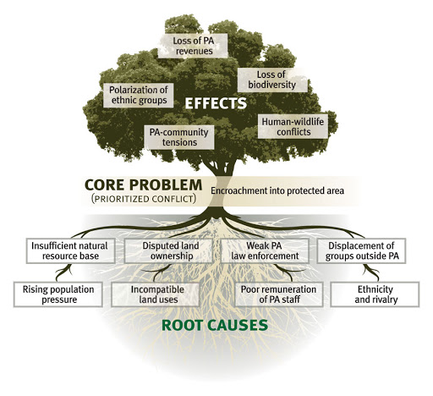
http://www.mspguide.org/tool/problem-tree

Slide 24
Variations
Objective Tree: Following the problem tree analysis, it is possible to rephrase each of the problems into positive desirable outcomes – as if the problem had already been treated, the problem can be turned into an objectives tree.
In this way, root causes and consequences are turned into root solutions, and key project or influencing entry points are quickly established.
Opportunity Tree: Instead of focusing on ‘problems’ it is possible to use the tree to analyze opportunities.
This implies changing the initial question from “what is the problem and what are underlying causes” to “what works well and what are underlying causes”.
http://www.mspguide.org/tool/problem-tree

Slide 25
http://www.mspguide.org/tool/problem-tree
http://web.undp.org/evaluation/handbook/documents/english/pme-handbook.pdf
https://www.ifrc.org/Global/Publications/monitoring/PPP-Guidance-Manual-English.pdf

Slide 26
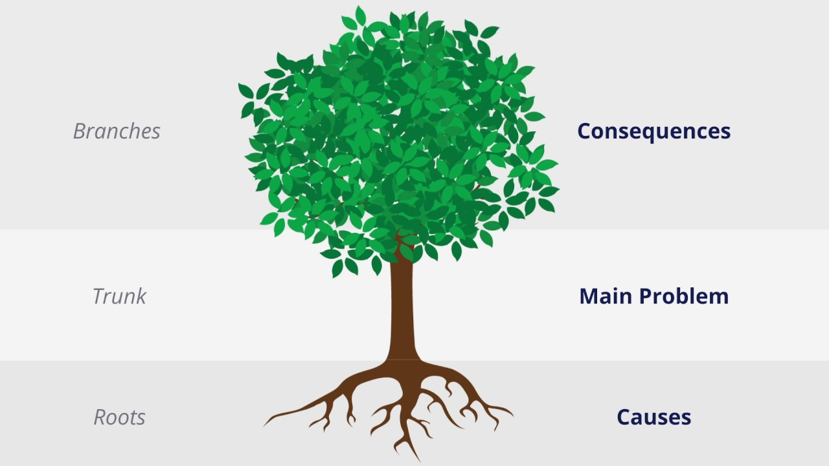
End of Module 3 (Week 4)
Do SWOT Analysis relative to you problem in mind that you work on until the end of the course

